Slide 1
AI Survey Team
Framing Presentation
Bjorn Sjogren, Kevin Miller, Rhyan Luther, Zhanyi Qi
Notes:
Bjorn

Slide 2

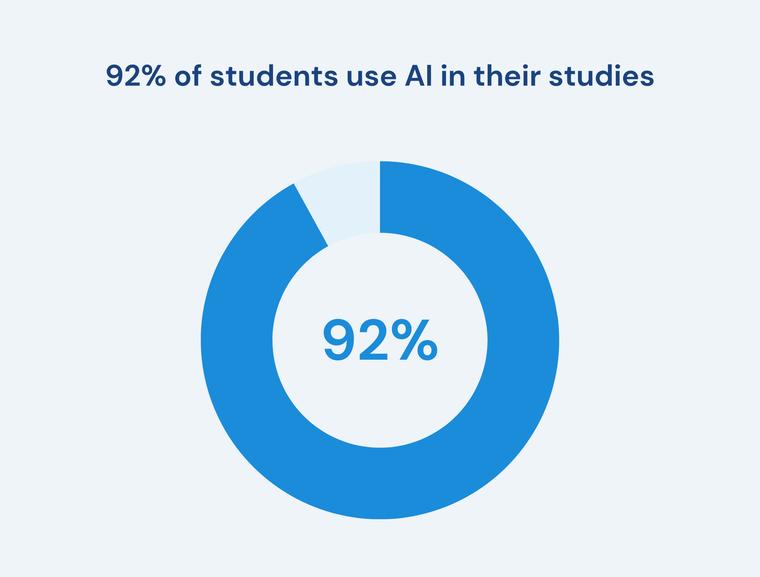
Issue
Tension between high rates of student AI use and inconsistent institutional policy
Difficult to enforce rules on AI without knowing how, why, and where students are using it
Teachers largely believe that being able to work with AI is important, but don’t want it to entirely replace coursework
https://programs.com/resources/students-using-ai/
Notes:
Bjorn

Slide 3
Framing Questions
Wake Forest has collected data about how students are using AI but do not currently have an understanding of:
How students are actually using AI?
What is the overall structure of GenAI use frequency? (And its potential interaction with schools and majors - Q2/Q15/Q16
What students believe AI’s role should be in higher education?
How many belongs to the contradictory group characterized by both high self-efficacy and high risk perception? Low efficacy low risk perception? What kind of support do each group need? - Q9/Q10/Q14/Q12/Q24
How AI usage and attitudes differ across groups on campus (ex: undergraduate vs graduate, school of business vs non school of business)
Do students systematically overestimate/underestimate their peers' usage (normative misperception)? How does this relate to their own usage intensity? - Q2/Q26/Q28
Notes:
Zhanyi

Slide 4
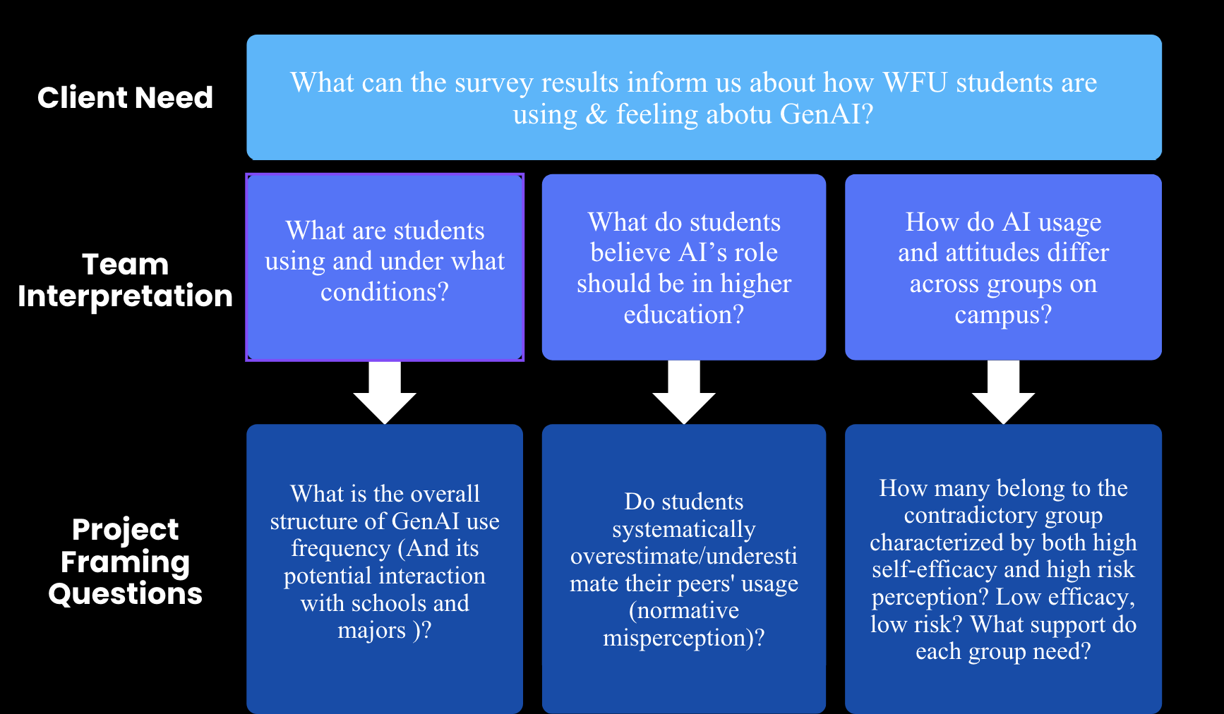

Slide 5
Causes of the Problem
AI tools consumer continue to evolve faster than university policies can adapt
Faculty may view GenAI through the lens of academic dishonesty while professionals emphasize the importance of AI proficiency for students entering the workforce
Existing survey data has not been translated into actionable insights
WFU does not yet possess benchmarking context or know what “normal” AI usage looks like at other peer universities
Notes:
Kevin

Slide 6
Value of the Problem
Clear and Fair Policies: Creating consistent guidelines helps reduce confusion and stress around what is and isn’t allowed, while still encouraging responsible innovation.
Protecting the WFU Degree: Moving away from strict, unclear enforcement and toward more meaningful assessments helps maintain the value and integrity of a Wake Forest education.
Preparing Students for the Real World: Supporting thoughtful use of AI ensures graduates are career-ready without lowering academic standards.
Notes:
Rhyan

Slide 7
Boundaries & Assumptions
Boundaries: This analysis focuses strictly on WFU student survey data from the current academic year; it does not include faculty-side surveys or external community data.
Assumptions: We assume "Self-Reported" data is accurate and that the anonymized responses represent the broader student body diversity.
Notes:
Bjorn

Slide 8
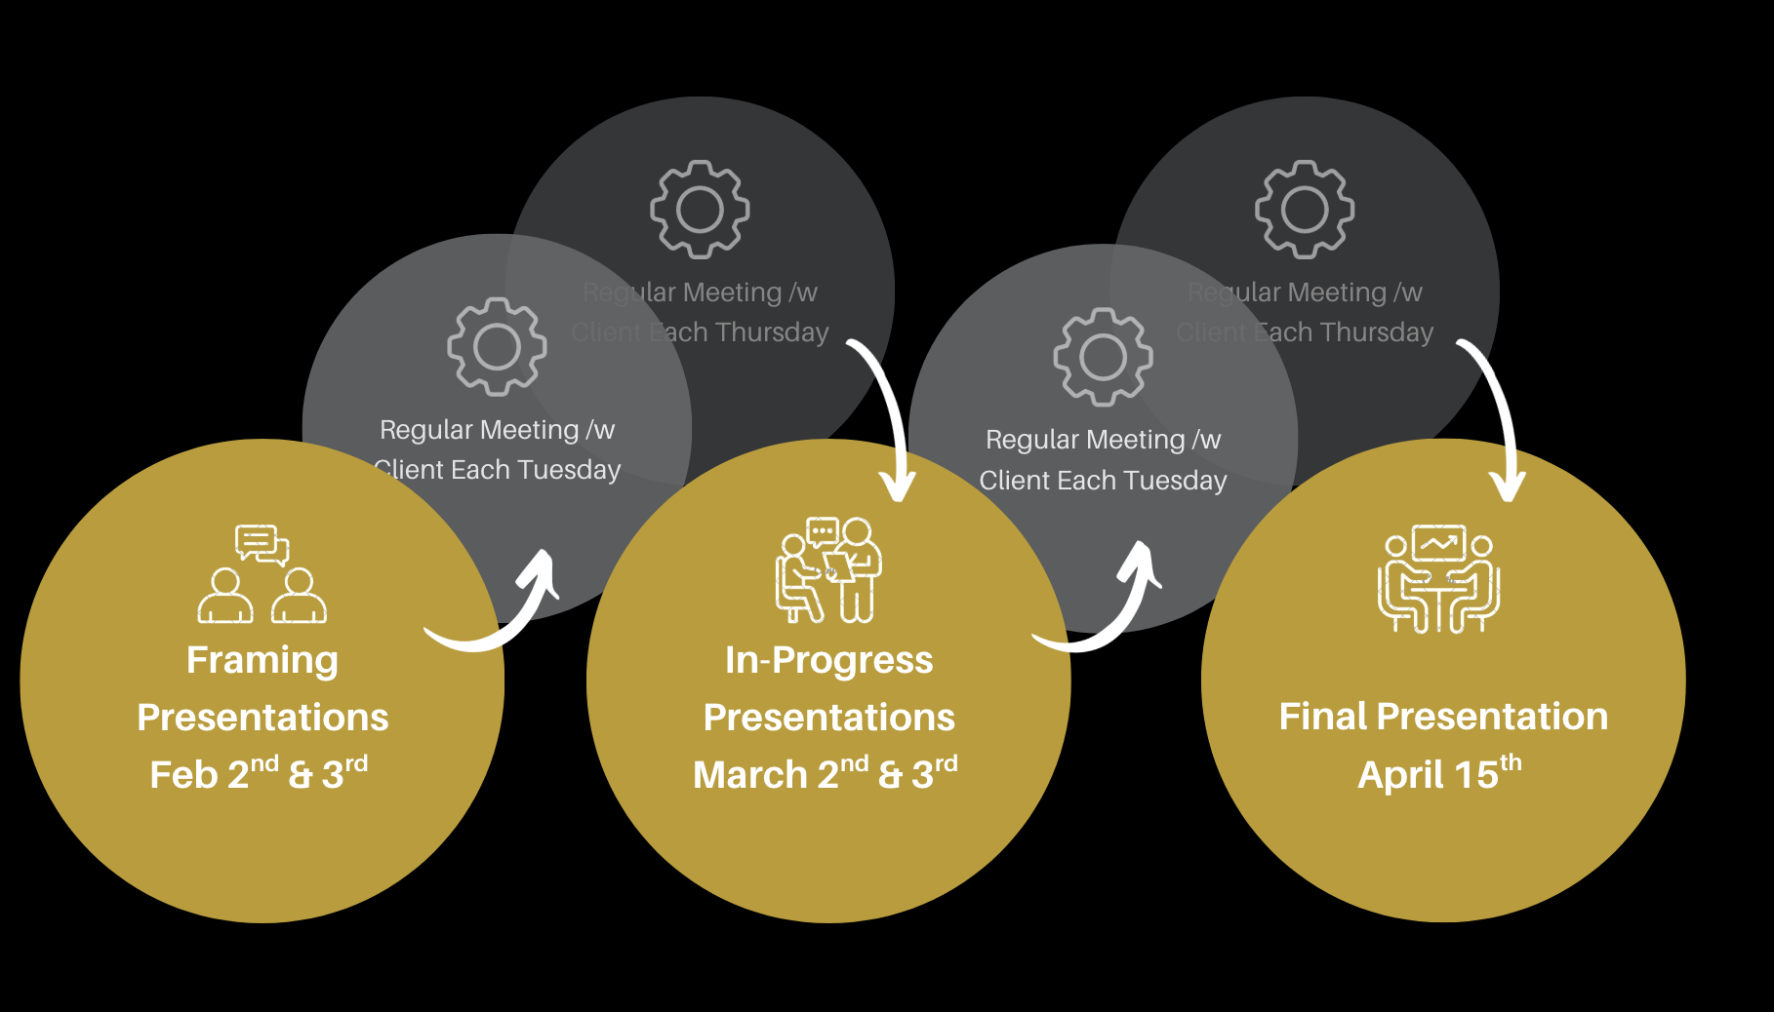
Timeline

Slide 9
How Do We Know We’ve Succeeded
Identified key student use cases and segments regarding AI use
Extracted interpretable themes from open-ended responses about AI’s role in higher education
Developed meaningful differences and themes between student groups regarding their AI use (class year, school, program)
Effectively compared Wake Forest to other peer institutions on their AI usage and attitudes
Produced actionable recommendations for Professor McKeen based on our analysis
Notes:
Kevin

Slide 10
Thanks

